Slide 1

Code Refactoring and Bug Report Analysis
Prepared by: Angad Gupta

Slide 2
About me
Hello, I'm Angad Gupta, currently pursuing a Bachelor of Technology (B-Tech) degree in Computer Engineering at RK University.
I want to learn data science because it's incredibly useful. It has a big impact on different industries and can help find important information in complicated data. Learning about data science is not just interesting, but it also gives me lots of chances to work in cool areas like artificial intelligence, machine learning, and predictive analytics.
While I haven't gained any professional work experience yet, I am eager to apply my theoretical knowledge in practical settings and contribute meaningfully to projects.
Below are my GitHub and LinkedIn profiles:
GitHub: https://github.com/Angad143
LinkedIn: https://www.linkedin.com/in/angad-gupta143/

Slide 3
Report Outline
Project Overview
Bug Analysis
Issue Identification
Resolution Strategy
Implementation Changes
Updated Code

Slide 4
Project Overview:
The Note Taking Application is a Python-based web tool developed using Flask for the backend and HTML for the frontend. It allows users to input and view notes in a simple interface. The primary functionalities include adding notes via a form and displaying them in an unordered list on the same page.
Additional Points:
Technologies: Python, Flask, HTML.
Main Features: Note addition, instant display.
Bug Analysis:
The Note Taking Application initially suffered from various operational and presentational issues:
Incorrect form submission method configuration led to note addition failures.
Inadequate HTML layout styling resulted in a visually unappealing interface.
Misalignment of the note display affected the overall layout consistency.
Limited request handling in the index() route, configured to handle only POST requests, led to issues retrieving notes from request arguments (request.args.get("note")).

Slide 5
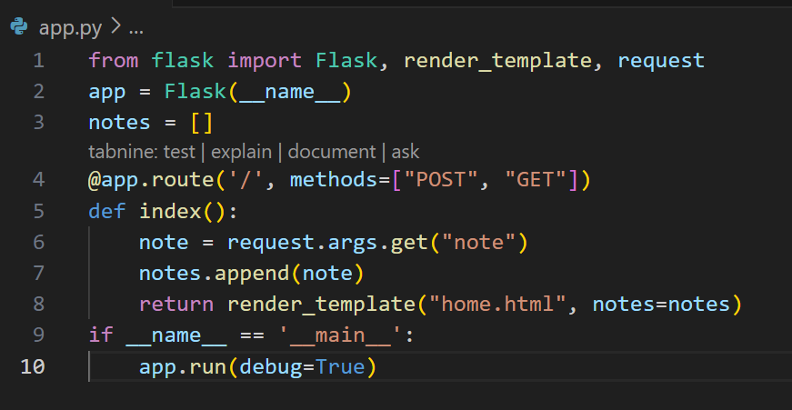
Initial Code:

Slide 6
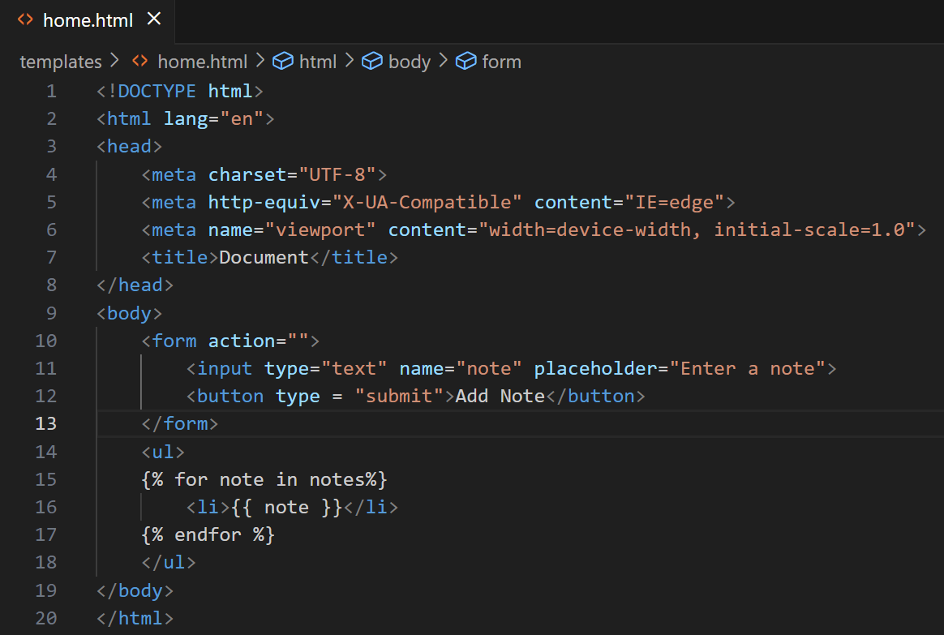

Slide 7
Issue Identification:
Misconfigured form submission method prevented successful note addition.
Inadequate HTML layout styling detracted from the user interface.
Lack of alignment in note display caused visual inconsistencies.
Additional Points:
Root Causes: Configuration oversight, styling deficiencies.
Resolution Strategy:
Correct the form submission method to facilitate seamless note addition.
Enhance CSS styling to improve the visual appeal and consistency of the interface.
Adjust CSS properties to ensure proper alignment of the note display.
Additional Points:
Approach: Incremental debugging and styling refinements.

Slide 8
Implementation Changes:
Updated form action and method in app.py for proper note submission.
Enhanced CSS styling in styles.css to improve interface aesthetics.
Adjusted CSS properties to centrally align the note display within the container.
Additional Points:
Testing: Thoroughly tested changes to ensure functionality and visual improvements.
Refactoring: Reviewed and optimized existing code for clarity and efficiency.

Slide 9
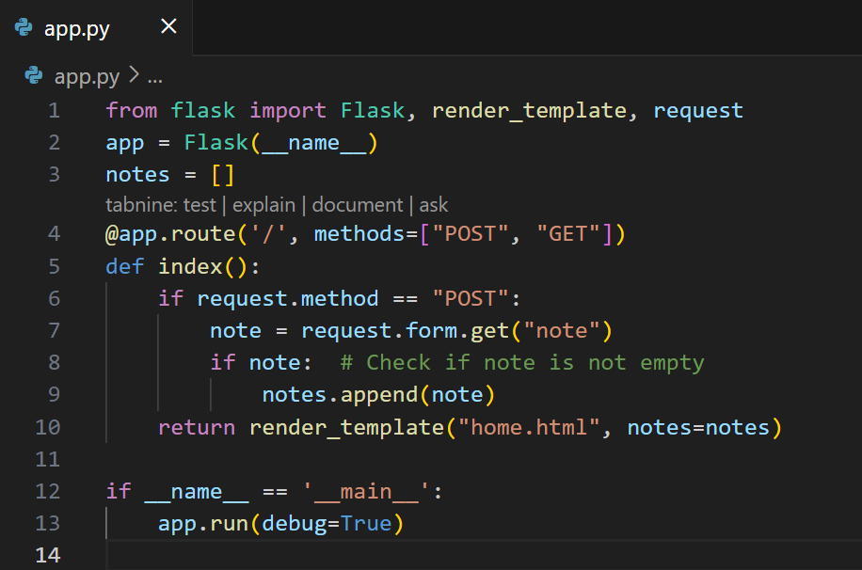
Updated Code:

Slide 10
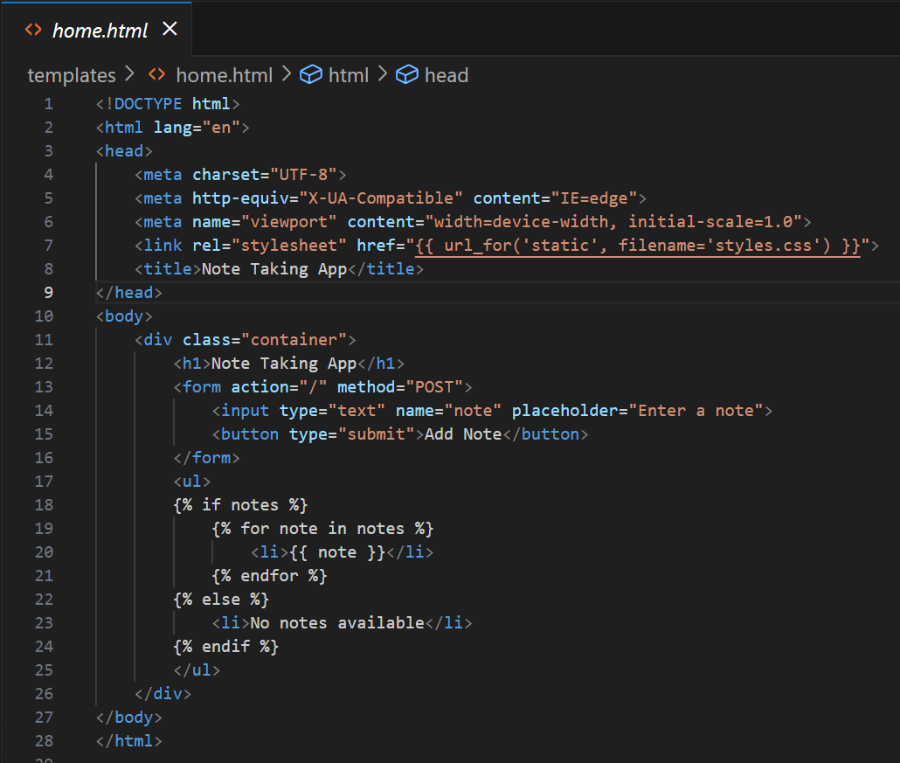

Slide 11
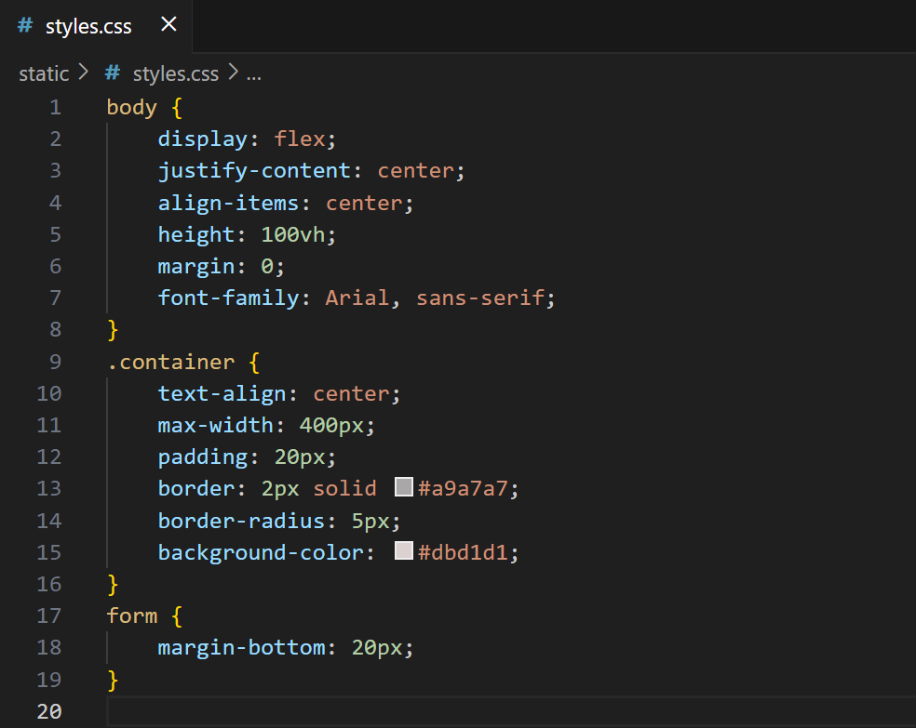

Slide 12
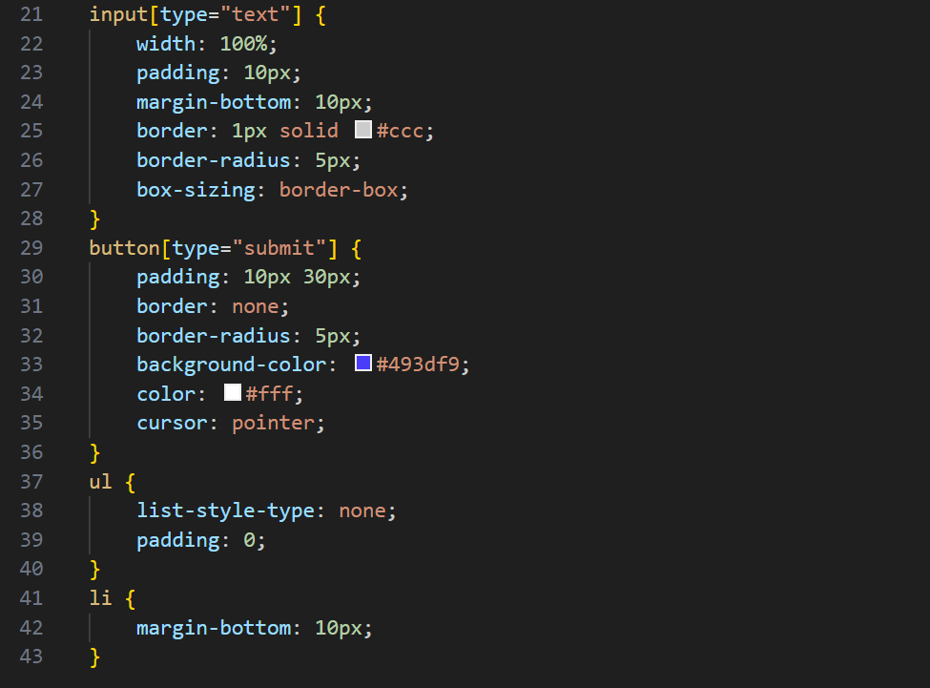

Slide 13
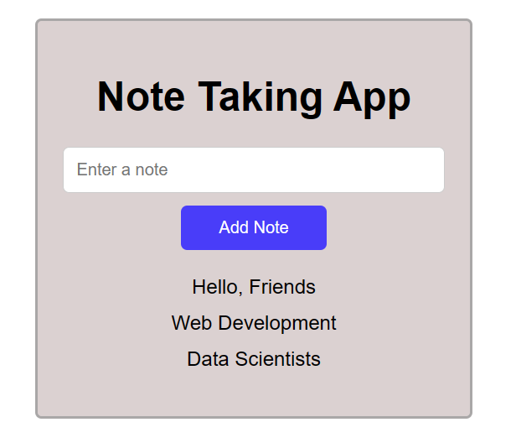
Final Output of the Project:

Slide 14
Conclusion:
By updating the Flask route to handle both GET and POST requests and adjusting the logic to retrieve notes from the form data for POST requests, the bug has been successfully resolved, restoring the application's intended functionality. Moreover, these changes have not only fixed the issues but also enhanced the application's usability with a more intuitive and user-friendly interface. This iterative process of code refactoring and bug resolution has significantly improved the Note Taking Application, making it a more valuable tool for efficient note-taking and organization.

Slide 15

THANK YOU

